Slide 1





CUSTOMER SEGMENTATION AND PERSONALIZATION
Name: PRINCE DHANISHA A Guide: P.Raja,Master Trainer
NM-ID: aut923821114303
E-Mail:princedhanisha@gmail.com
Disclaimer: The content is curated for educational purposes only.
Notes:
Slides: Prepare a short slide deck (10-12 slides) summarizing the project objectives, methodology, and key results.

Slide 2
OUTLINE
Abstract of the Project
Problem Statement
Proposed Solution
System Architecture
Embedded Video of Project
Conclusion
Future Scope

Slide 3
Abstract
The project on Customer Segmentation and Personalization explores the use of data analytics and machine learning techniques to enhance customer experiences by segmenting the customer base and tailoring offerings to individual preferences. The primary objective is to divide a diverse customer group into homogeneous segments based on factors such as purchasing behavior, demographics, preferences, and interactions with the brand.

Slide 4
Problem Statement
The business lacks an effective way to segment its customer base and personalize offerings, communications, and services based on individual customer characteristics, behavior patterns, and preferences.
Marketing campaigns are too broad or irrelevant, resulting in low engagement, poor conversion rates, and wasted advertising spend.

Slide 5
Proposed Solution
Customer segmentation and personalization are critical strategies for businesses to improve customer satisfaction, increase retention, and boost revenue. Here's a proposed solution.
Data Collection
Data Analysis and Segmentation
Personalized Engagement Strategies
Tools and Technologies
Testing and Optimization

Slide 6
System Architecture
Here is a proposed system architecture for customer segmentation and personalization. It ensures scalability, real-time processing, and integration across multiple channels.
Data sources Layer
Data Ingestion Layer
Data Storage Layer

Slide 7
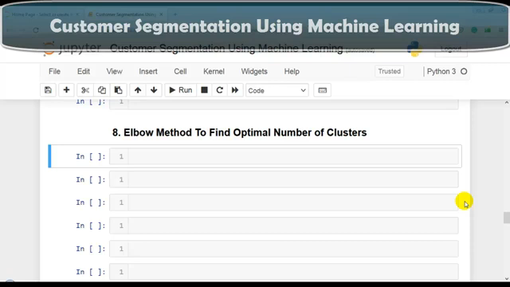
Video of Project Demo

Slide 8
Conclusion
This project has successfully demonstrated the power of customer segmentation and personalization in enhancing marketing strategies and customer engagement. By applying K-Means clustering to segment customers based on Age and Annual Income, the project has provided valuable insights into how businesses can tailor their offerings to different customer groups.

Slide 9
Future Scope
The future of customer segmentation and personalization is driven by advancements in technology, data availability, and evolving customer expectations. Here's a detailed look at the potential future developments.
Real-time Segmentation
Enhanced dtta Utilization
Omnichannel Personalization
Emotional and Behavioral Personalization

Slide 10
Thank you!
Notes:
thank you very much for joining this PPT, keep learning.
10

